Slide 1
Kart racing
To feel yourself just like a Formula 1 driver

Slide 2
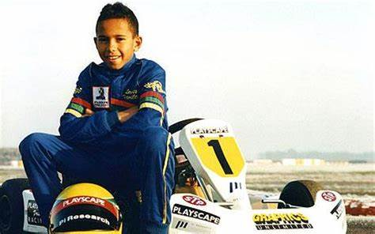
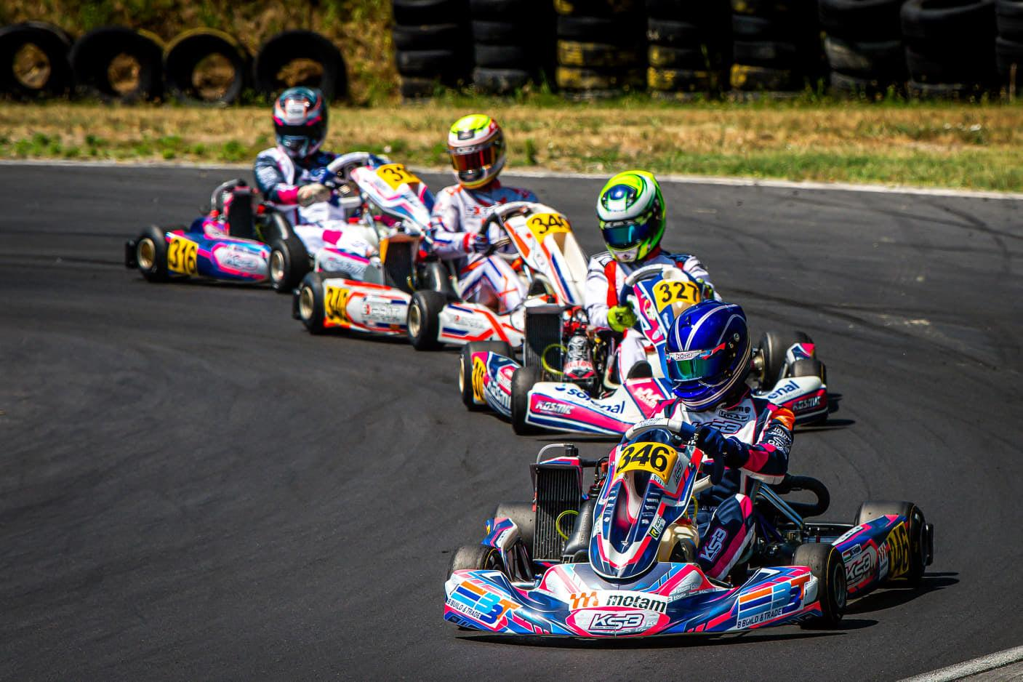
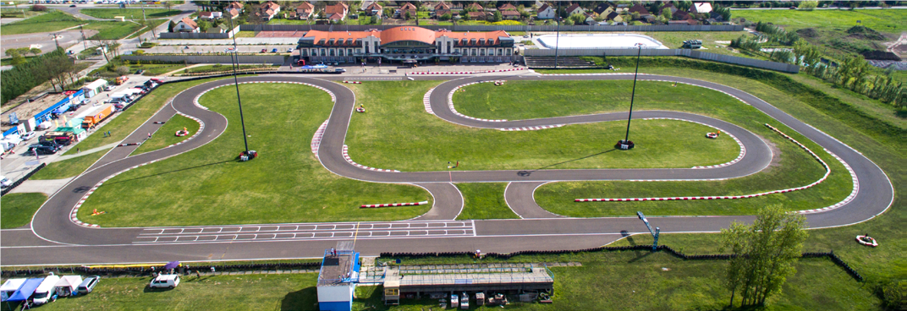
What is kart racing?
Kart racing or karting is a road racing variant of motorsport with open-wheel, four-wheeled vehicles known as go-karts or shifter karts.
Kart racing is usually used as a low-cost and relatively safe way to introduce drivers to motor racing.
Kart racing is generally accepted as the most economic form of motorsport available on four wheels. As a free-time activity, it can be performed by almost anybody, and as a motorsport in itself, it is one of the sports regulated by FIA, permitting licensed racing for anyone from the age of 8 onward.
Karting is commonly perceived as the stepping stone to the higher ranks of motorsports, with many Formula One champions, just like as Ayrton Senna, Niki Lauda, Lewis Hamilton, Michael Schumacher, Fernando Alonso, etc.
Karting is international and most countries have kart specific racing circuits. In Hungary, Kecskemét, there is a big kart circuit, licenced by the FIA (for international kart racing). But there are more than 10 smaller kart circuits in the region of Pest.

Slide 3
Where can u try out karting?
Gokart stadion, Kecskemét
Hungaroring kart center, Mogyoród

Slide 4
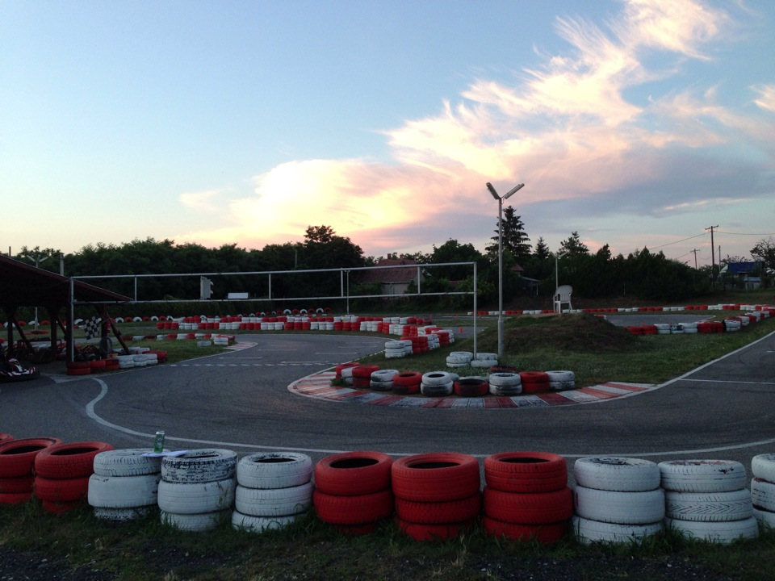
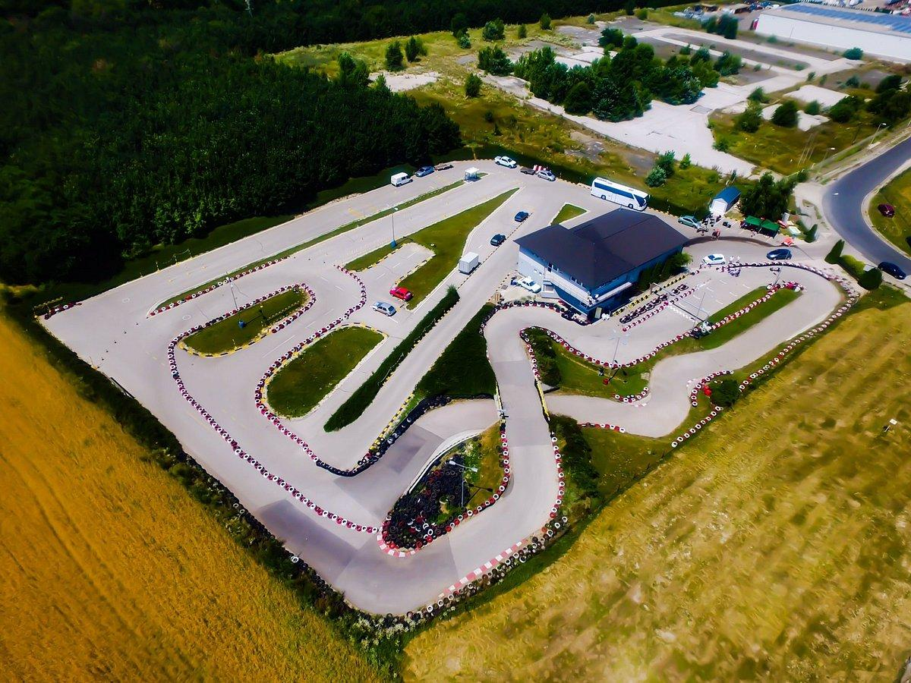
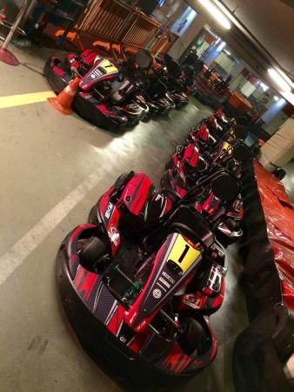
Where can u try out karting?
Kart Farm, Csömör
Battaring, Százhalombatta
G1, Asia center

Slide 5
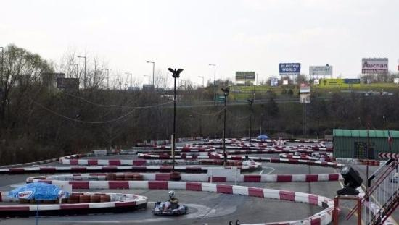
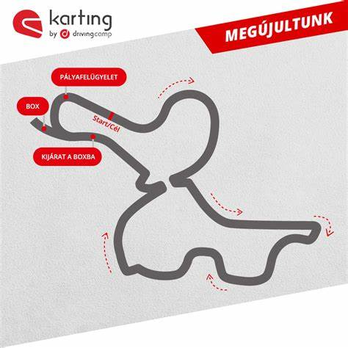
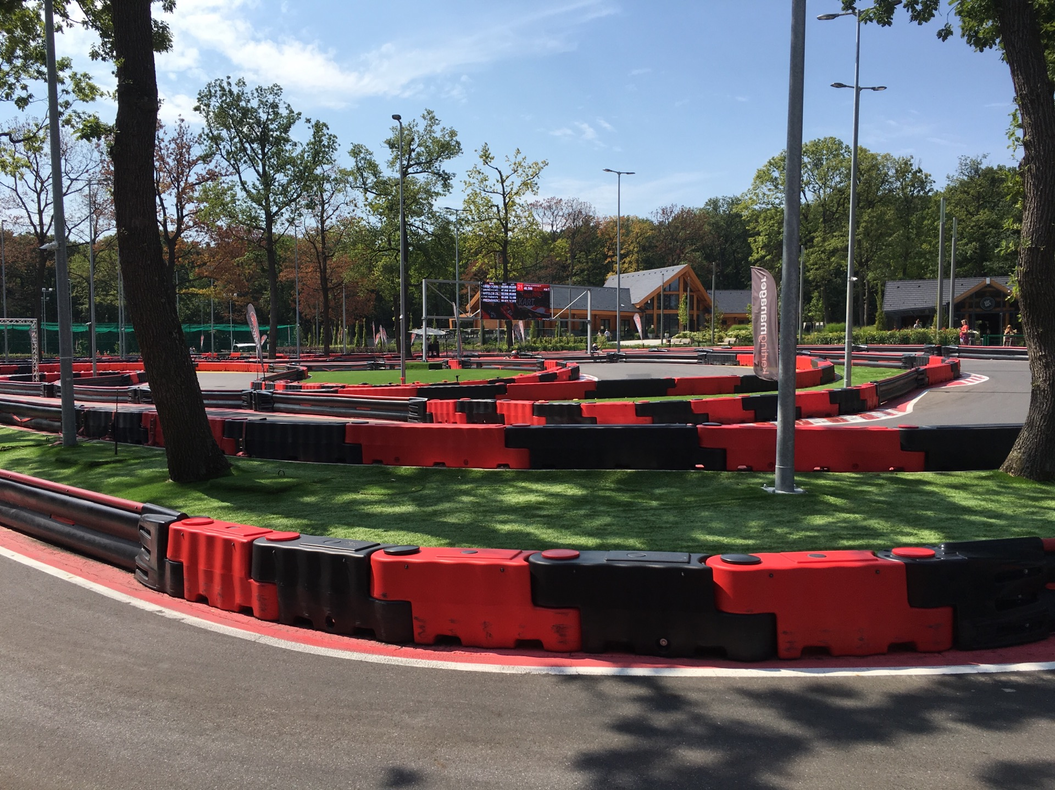
Where can u try out karting?
Budaring, Budaörs
Hell kart, Miskolc
Driving Camp, Zsámbék

Slide 6
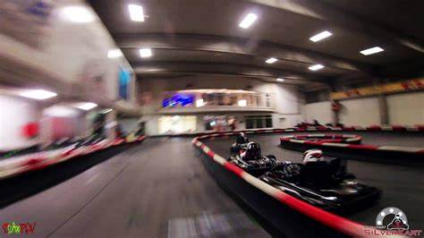
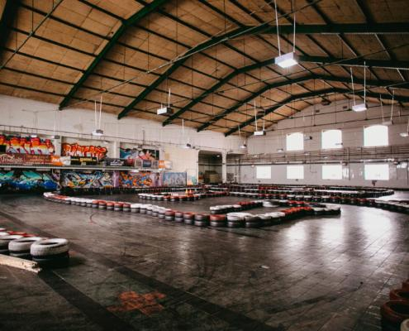
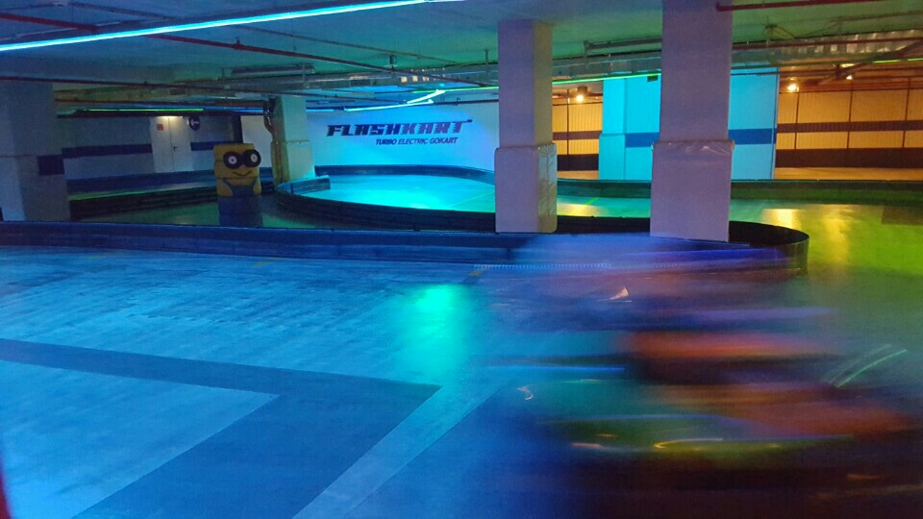
Where can u try out karting?
Silverkart, Budapest
Gokart aréna, Budapest
Flashkart, Budapest (electric kart)

Slide 7
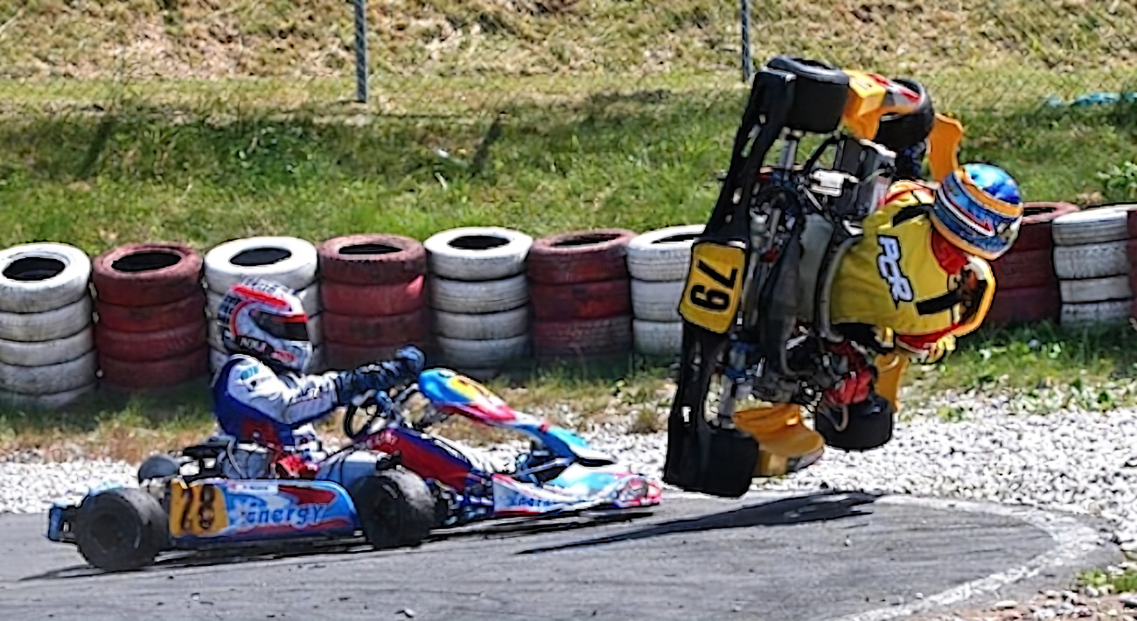
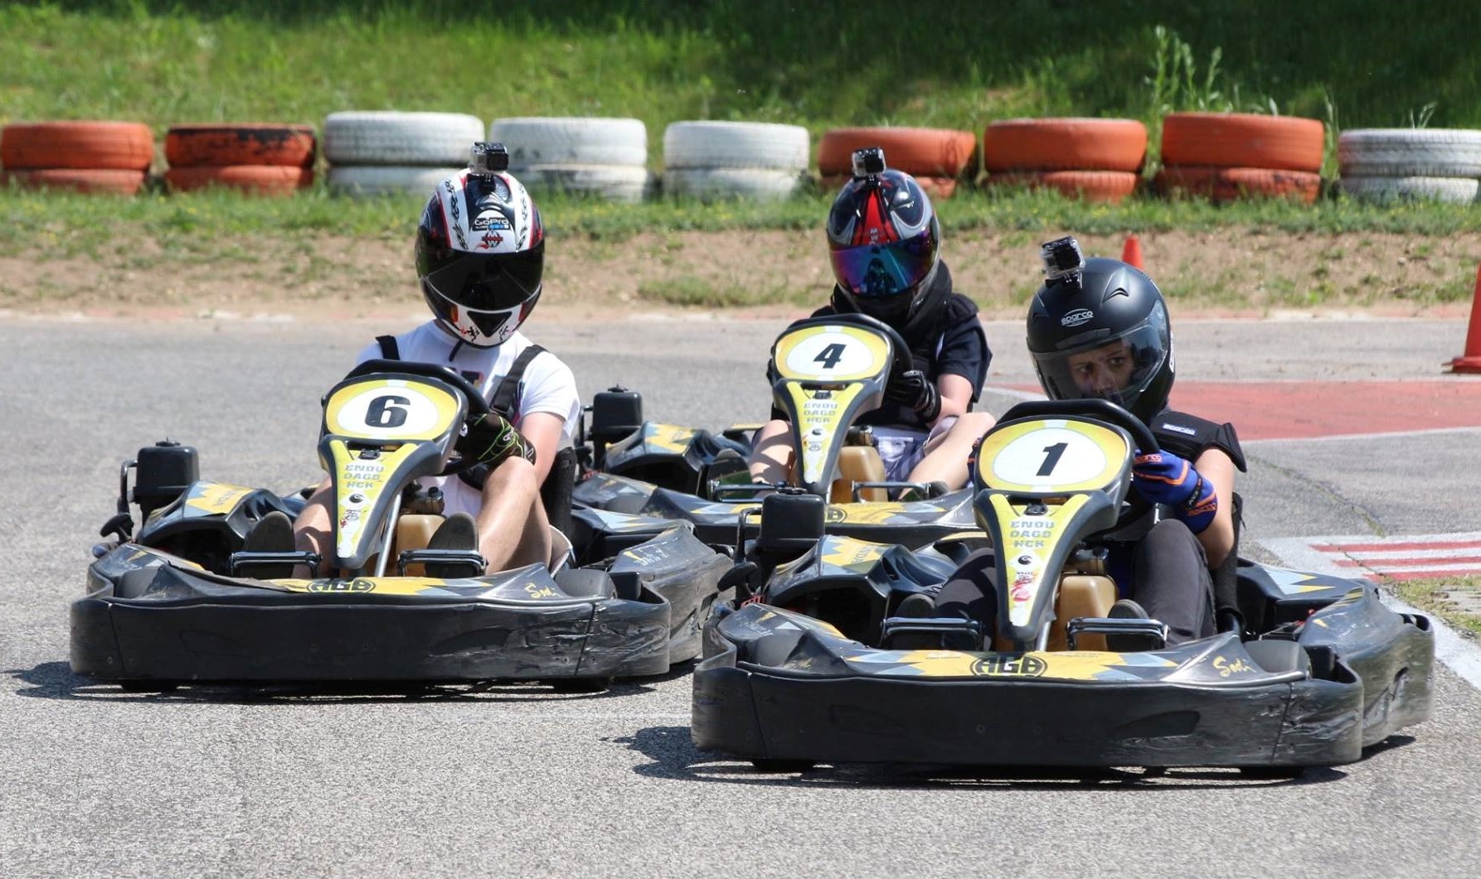
Why do u need to try out karting? Or why not?
Pros:
it’s a cool hobby
it gives u adrenaline
feel yourself as a formula 1 driver
it’s improve your drive skills
it’s good for your mental and physical health
learn how to focus, and to get the flow
get beautiful trophies
if u are a girl: u can beat the boys!
Cons:
it’s a dangerous sport
it’s pretty expensive sport

Slide 8
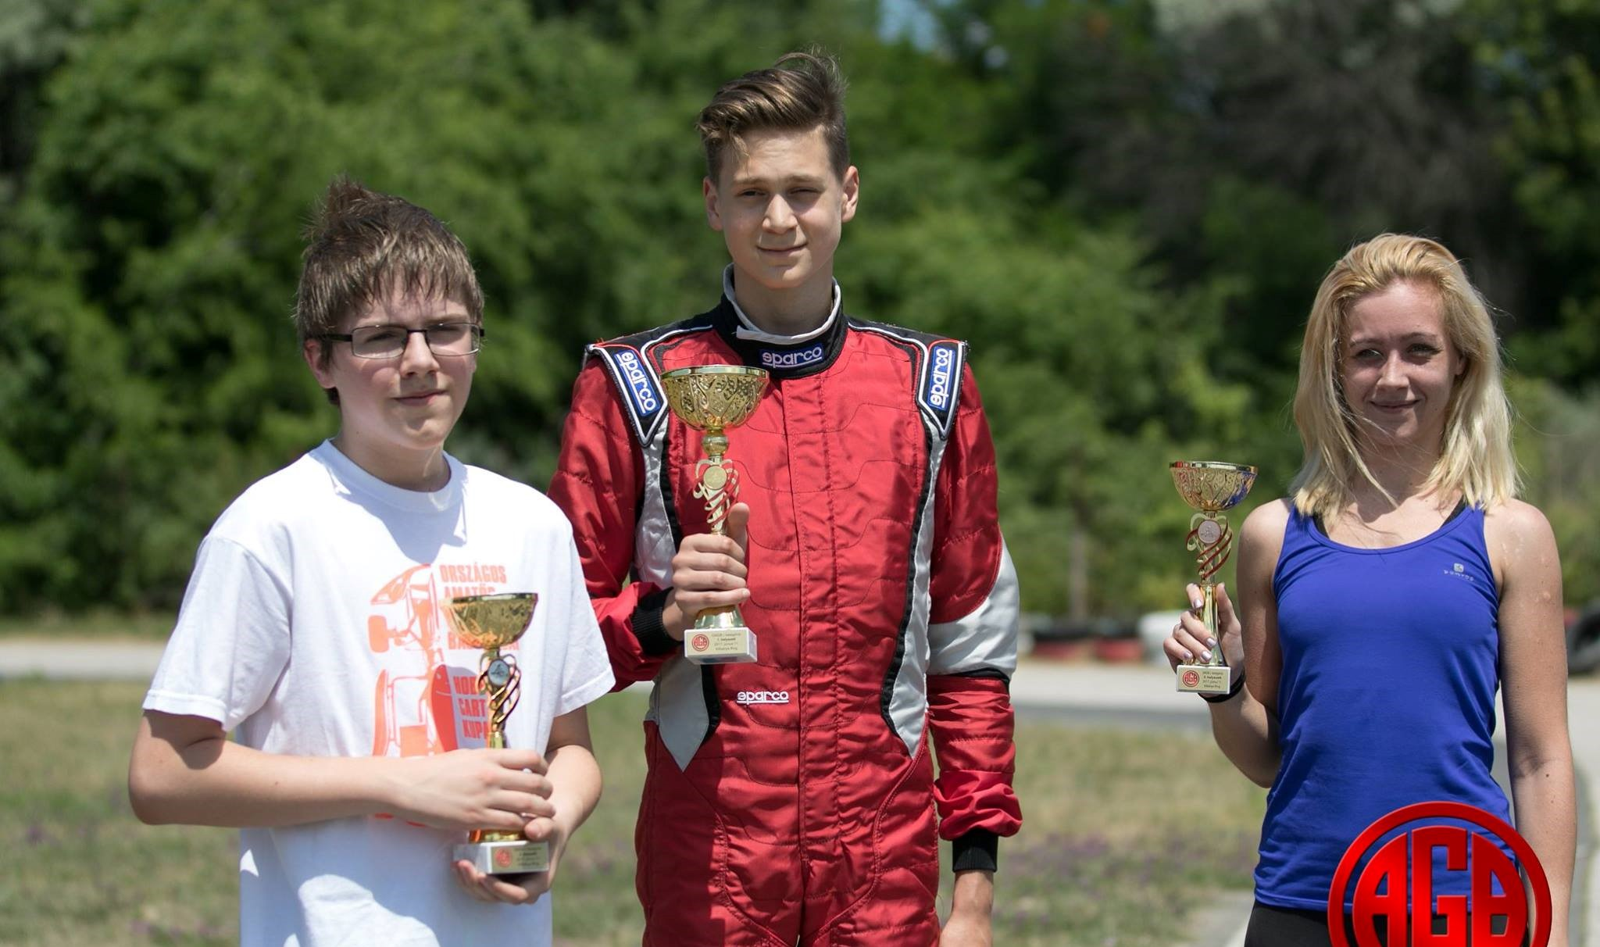
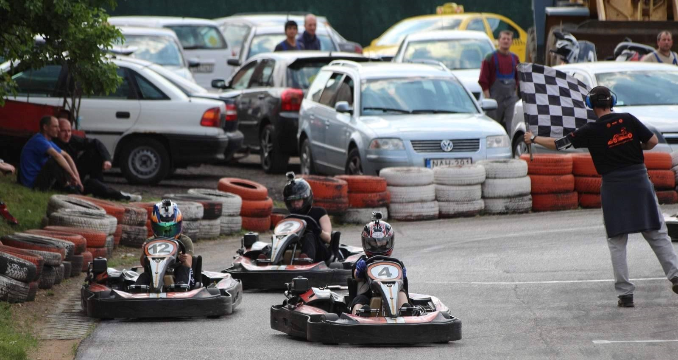
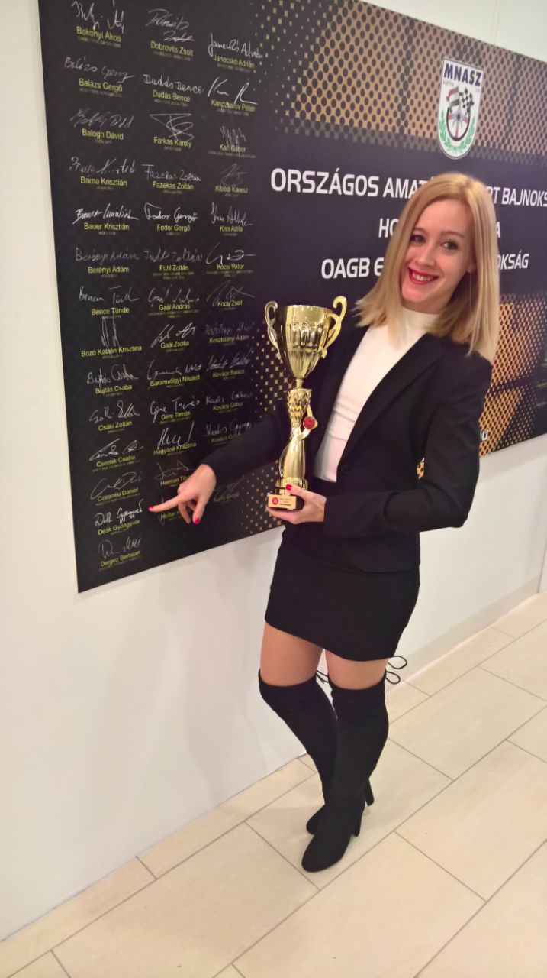
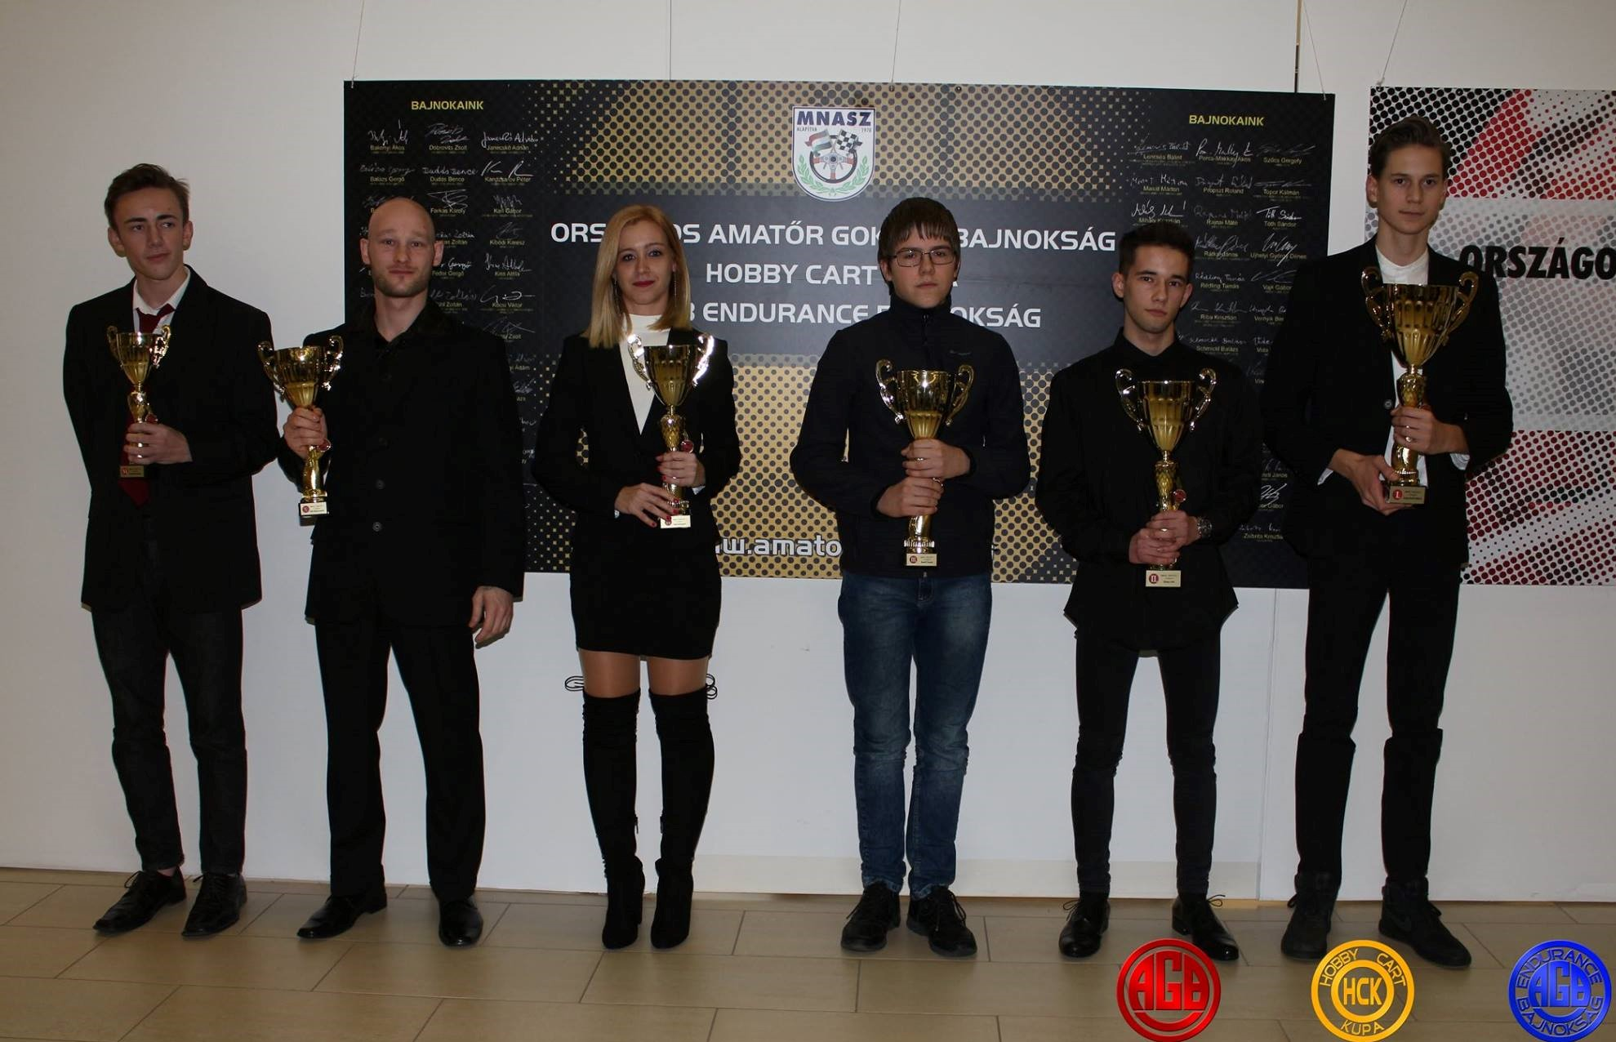

Why did i start to kart racing as a girl?!
Because i wanted to get my name on the Wall of the Champions, and become the best kart racing girl in Hungary!

